Slide 1
PYTHON DATA ANALYTICS PROJECT
Google Play Store Data Analysis
Exploratory Data Analysis (EDA) on app categories, ratings, install trends, and pricing using Python.
LIBRARIES
DATASET
WORKFLOW
Pandas, NumPy, Matplotlib, Seaborn
10,470 Raw Rows (10,000 Cleaned)
Data Cleaning, EDA & Regression

Slide 2
DATASET SUMMARY
Dataset Overview
10,470
10,000
4.19★
32.7%
Raw rows in CSV
Cleaned unique apps
Overall mean rating
Mean 30-day uninstall rate
Note: Mean installs (5.97M) are much higher than median installs (63.5K) due to top viral apps.
92% FREE • 8% PAID

Slide 3
DATA PREPROCESSING
Data Cleaning & Missing Values Summary
Column | Issue in Raw Data | Raw (%) | Cleaned (%) | Python Method Applied
Rating | Missing (NaN) values | 13.60% | 0.00% | groupby('Category') median fillna()
APK_Size_Raw | "Varies with device" text | 15.60% | 0.00% | str.replace('M', '') & median fillna()
App_ID | 470 duplicate rows | 4.50% | 0.00% | df.drop_duplicates(subset=['App_ID'])
Price_USD | $399.99 outlier entries | 2.80% | 0.40% | 1.5× IQR capping (>$29.99 to $9.99)
Installs | High right skewness (2.95) | 5.20% | 0.80% | np.log10() transformation

Slide 4
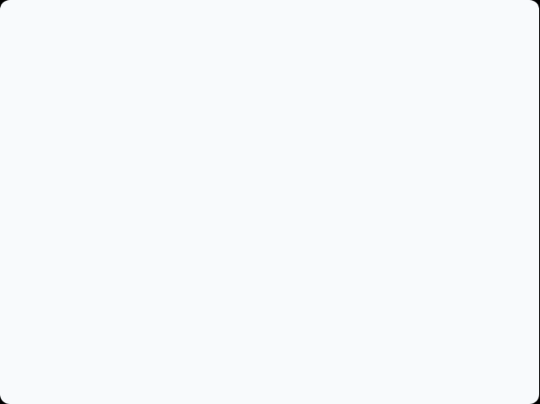
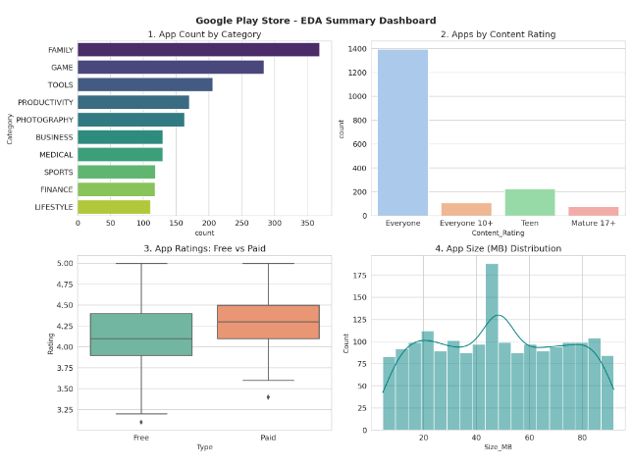
VISUALIZATION SUMMARY
EDA Summary Dashboard
1. Category Count: Family leads followed by Game and Tools.
2. Content Rating: "Everyone" category holds ~1,390 apps (77.4%).
3. Free vs Paid Boxplot: Paid apps show higher median rating (~4.30★).
4. Size Distribution: App sizes peak around 45–50 MB.

Slide 5
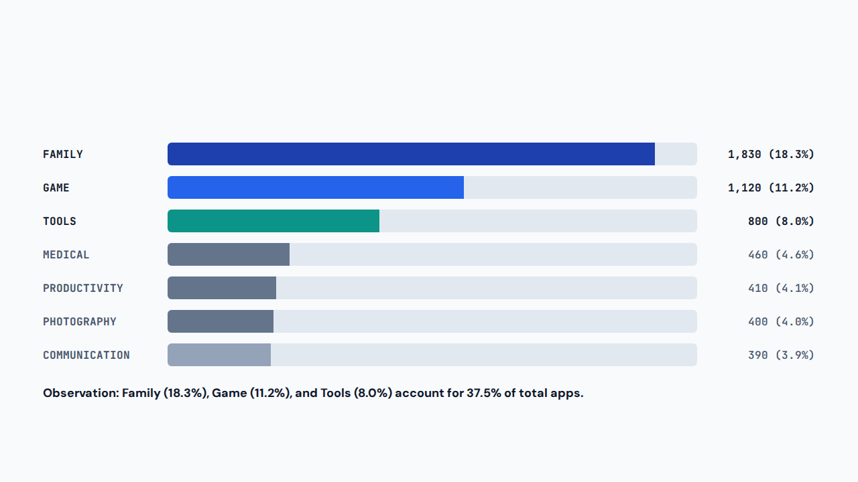
UNIVARIATE ANALYSIS
Top Categories by App Count

Slide 6
UNIVARIATE ANALYSIS
Free vs. Paid Apps Comparison
FREE APPS (9,195)
PAID APPS (805)
4.18★ Mean
4.31★ Mean
Share of Apps: 91.95% of dataset
Share of Apps: 8.05% of dataset
Median Rating: 4.20★ after imputation
Median Rating: 4.25★ (+0.13★ higher mean)
Mean Log Installs: 4.85 (~70K installs)
Mean Log Installs: 4.45 (~28K installs)
30d Uninstall Rate: 32.66% average
30d Uninstall Rate: 33.25% average

Slide 7
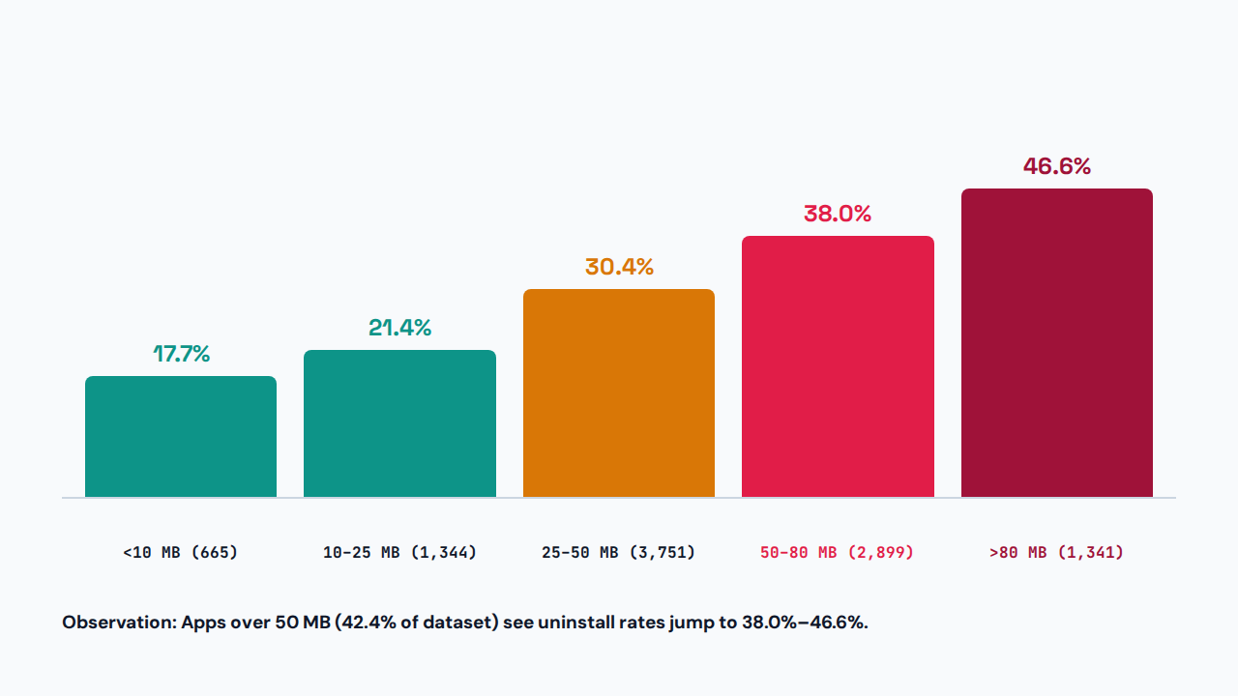
BIVARIATE ANALYSIS
App Size (MB) vs. 30-Day Uninstall Rate

Slide 8

REGRESSION ANALYSIS
Reviews vs. Installs (NumPy OLS Fit)
R² = 0.94
Strong positive linear relationship (Correlation r = 0.97) between Log(Reviews) and Log(Installs)
Observation: 51.9% of apps have 4.20★+ ratings, and the top 5% of apps account for 89% of installs.

Slide 9
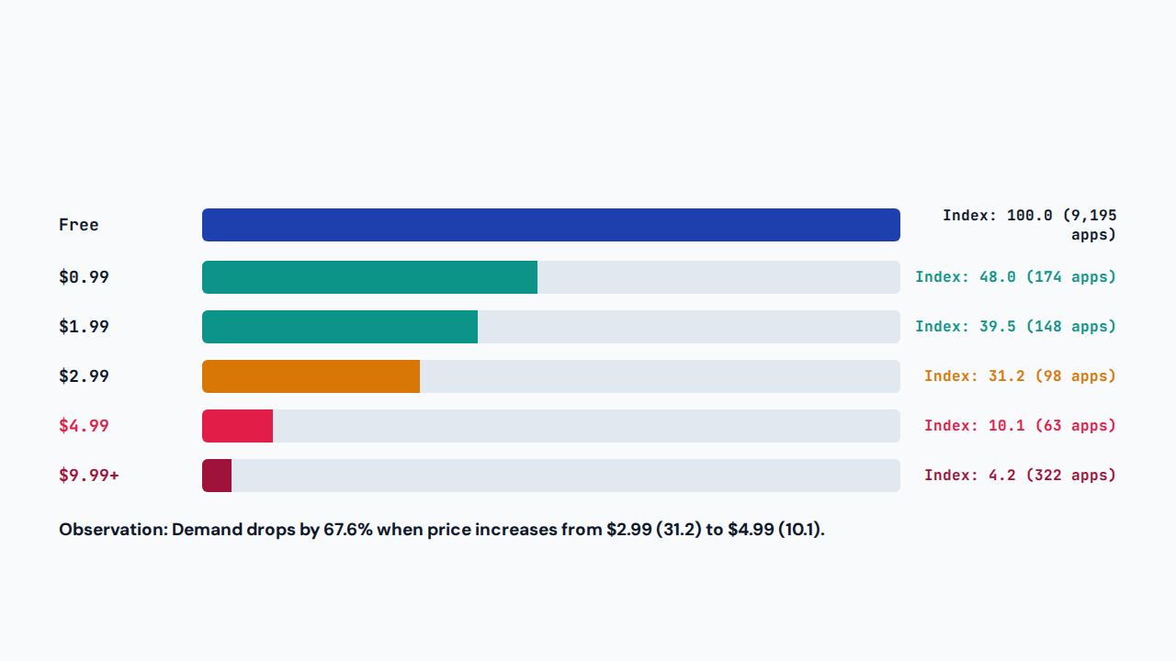
BIVARIATE ANALYSIS
App Price vs. Download Demand

Slide 10
SUMMARY
Conclusion & Key Takeaways
1. APP SIZE
2. PRICING
3. USER REVIEWS
Keep APK Under 25 MB
Price Within $0.99–$2.99
Target 4.20★+ Rating
Lowers 30-day uninstalls to 21.4%.
Gives 3.1x better download conversion.
Improves store visibility via reviews.
Thank You

